Slide 1
3D INTERNET
JAXN.NEELIMA
15WJ1A1219

Slide 2
Abstract
Internet today has become an integral part of our lives. The World Wide Web which started as a small dull data repository has now become massive and irreplaceable. Present activities being partially or completely linked with the virtual world can be optimized to a higher level. Every activity associated with our daily life is mapped and related to some entity in the digital world. The world has seen vast advancements in Internet and in 3D stereoscopic displays. Time has come merge the two to deliver a new level of experience to the users. 3D Internet is an idea which is yet to be implemented and requires browsers having the property of depth perception and artificial intelligence. If this property is incorporated then the idea of Internet of things can become a reality which is also discussed in this paper. In this paper we have discussed the features, possible setup methods, applications, and advantages and obstacles faced in the implementation of 3D Internet. Through this paper we intend to provide a clear idea about 3D Internet and the possible benefits associated which clearly are worth the amount of financial investment required for it’ s implementation.

Slide 3
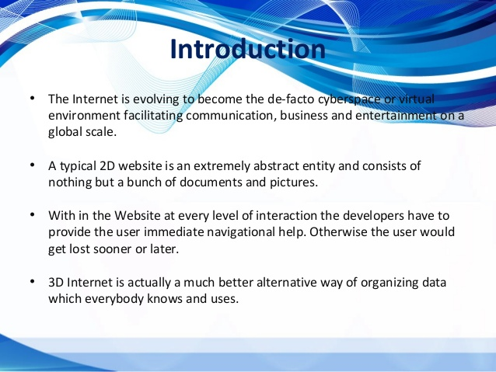

Slide 4
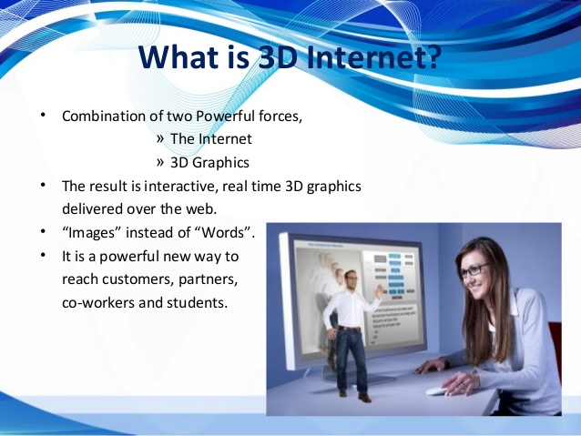

Slide 5
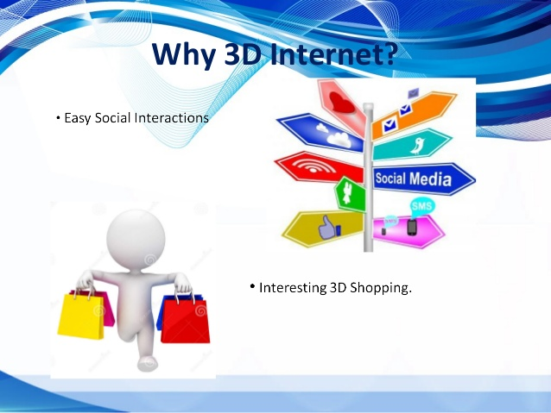

Slide 6
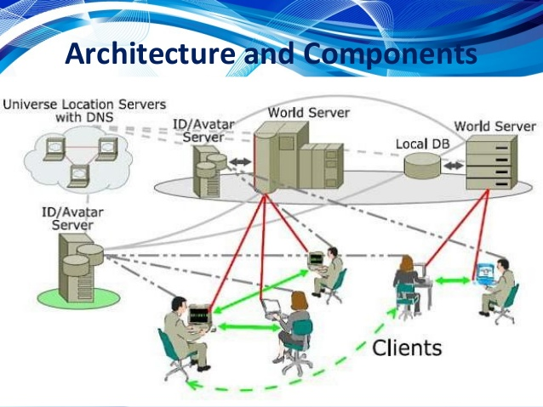

Slide 7
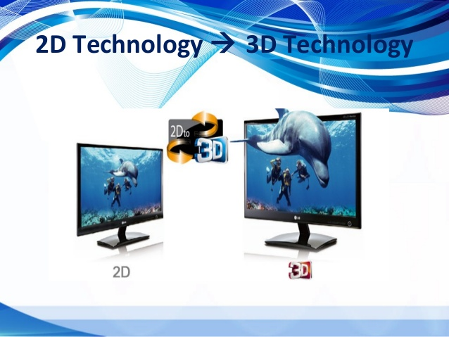

Slide 8
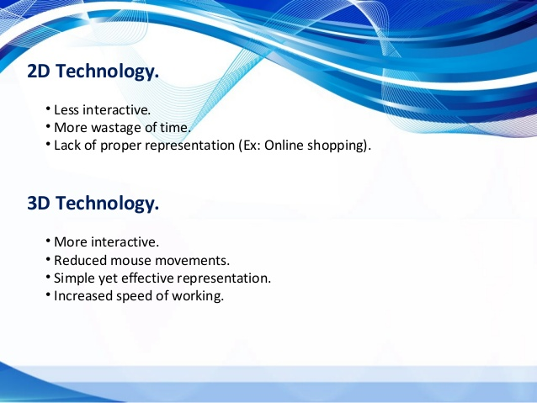

Slide 9
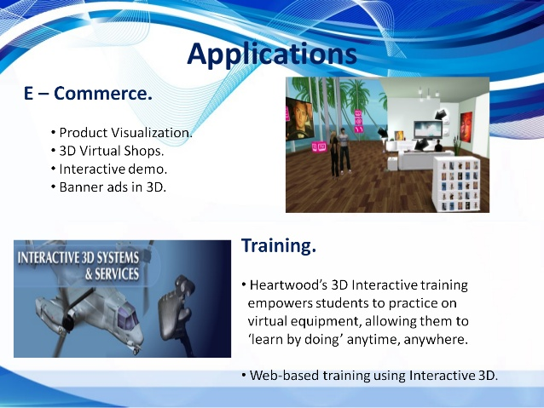

Slide 10
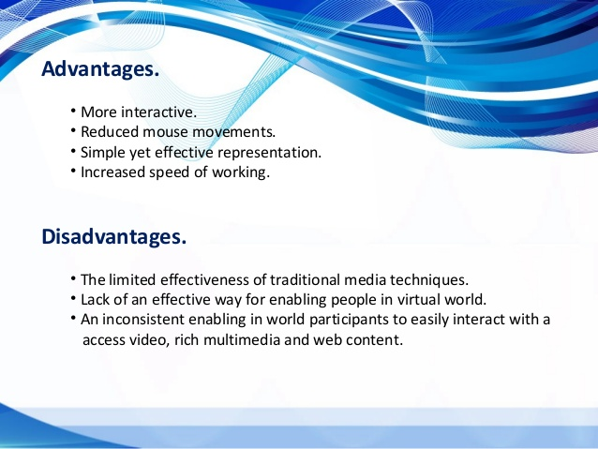

Slide 11
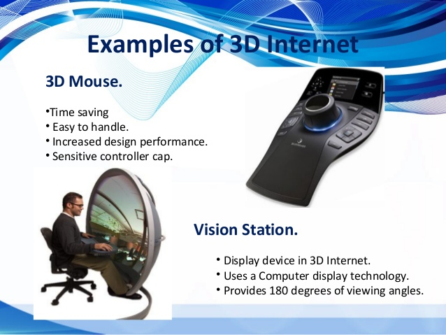

Slide 12
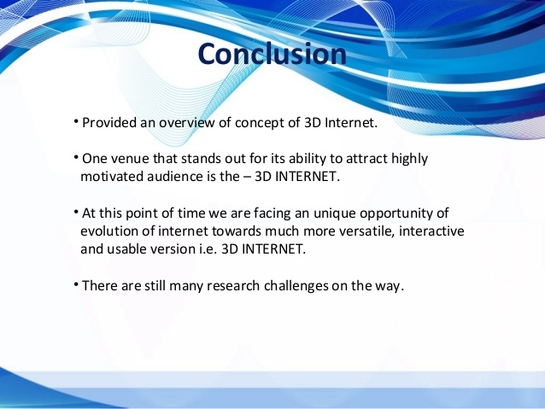

Slide 13
THANK YOU

